Slide 1

Peking University HSBC Business School
Graduate Thesis Seminar
Graduating in a bad economy: cohort differential wage
effects on Virginia higher degree holders
By: Jeremy Schutte

Slide 2
Contents
Introduction
Literature Review
Data and simulation
Empirical strategy
Results
Conclusion

Slide 3
Introduction - What is the effect of graduating in poor economic times?
I use economic indicators at or around graduation and a large simulated dataset to estimate the effect of graduating in poor economic times for Virginia higher degree holders.
Potential reasons for lower wages in the short run:
Lower full time employment
Lower offers than in good economic times
Potential reasons for lower wages in the medium to long run
Lower human capital accumulation from unemployment or lack of full employment
Lower medium and long term health outcomes for graduates of poor economic times, which leads to lower wages

Slide 4
Literature review
Oreopolous, Till von Watcher, and Heisz (2012), find that Canadian college graduates of a recession in the 80’s suffered earnings losses that faded over a decade.
They find that lower wages can be explained by an initial reduction in employer quality.
Kahn (2010) finds large, negative, and persistent effects on wages from graduating during bad economic times using the National Longitudinal Survey of Youth.
Cutler, Huang, and Lleras-Muney (2014) show that graduating in poor economic times results in lower incomes and health outcomes over time.
They find that a protective effect for more educated graduates

Slide 5
Literature review continued
Genda et al. (2010) show that there are differential effects for job market entrants during poor economic times by both education level and country.
In Japan - low education leads to persistently lower wages
In America – the effect quickly disappears with improving economic conditions, but the negative effect for more highly educated cohorts is more persistent.
Davis and Wachter (2011) use data from 1974 to 2008 to claim differential wage losses based on the severity of the downturn
2.8 years of pre-displacement earnings are lost when mass layoffs occur during recessions with unemployment levels of 8% or above
1.4 years of lost pre-displacement earnings are lost when mass layoffs occur during times of unemployment of 6% or less.
Due to the nature of the data used, my study can only study how much lower wages are from various economic indicators at graduation conditional on employment.

Slide 6
Data sources
Economic indicator | Source of indicator
US GDP growth | BEA
US unemployment | BLS
VA GSP growth | Virginia state website
VA unemployment | Virginia state website
Primary data source -SCHEV's Guide to the Mid-Career Wages
Yearly distributional wage data for Virginia higher degree graduates
25th, 50th, 75th percentiles of income and number of reporting workers for one year’s wages of a given graduation year – degree level cohort
Wage data from 1998-2013 for graduates of the classes of 1993-2011.
Adjusted for inflation to equal 2009 dollars.
Types of higher degrees | 4 year bachelor’s
Less than 1 year certificate | 5 year bachelor’s
1-2 year certificates | Post bachelor’s
Associate’s, bachelor’s degree credits | Master’s
Associate’s, technical degree credits | Post master’s
Doctoral | Professional

Slide 7
If you look carefully, you can see that the first few years of wages are lower for the graduation cohorts of 2008 on across most degree types.

Slide 8
Simulation of individual wages
Percentile ratios
75th:50th | 50th:25th
1.417 | 1.362
Most wages follow something close to a log-normal distribution
For a log normal distribution - 75th:50th and 50th:25th ratio are the same
An equal weighting of my data by represented observations yields:
Assuming that my data was log normally distributed, I simulated 1592 and 2178 log-normal distributions because of later finding an updated dataset
Then I investigated the following to see how well my distributions fit my data:
How the error of the simulated distributions varied with income (slightly)
How the error varied with economic indicators (very slightly)
Whether including an adjustment for the error changed my results (the simulation error biased my estimates downward very slightly, not a major cause for concern)
The only way I had to measure error was to see how far off the 50th percentile from the original data was from the 50th percentile of the simulated distribution.

Slide 9
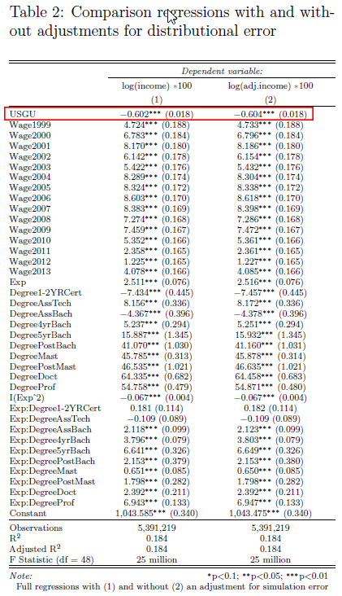
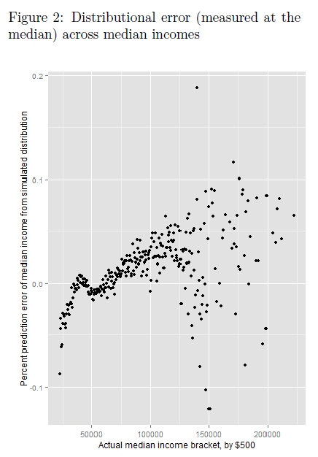
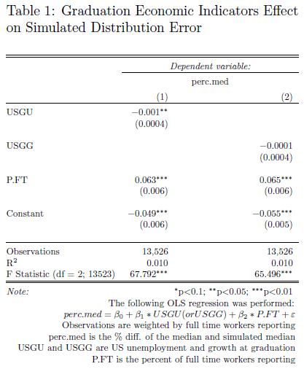
Simulation error checks

Slide 10
Empirical strategy
Term | Meaning
ln(SW_i) | Log simulated wage of individual i (cannot be compared across years)
EI_g | Economic indicator being used, belonging to graduation cohort g (its value is determined based on the graduation year)
Exp | A proxy variable for experience: = Wage year – graduation year
Yr_t | Wage year set of dummy variables
Deg_d | Degree type set of dummy variables
I used pooled OLS with fixed wage year and degree effects.
My proxy for experience was the other control variable
The main predictor of interest was the economic indicator from around the year of graduation (on, one year after, or one year before) and possibly its interactions.
Many of my regression formulas were similar to the one below.

Slide 11
Results – types of regressions performed
Simple validation regressions on training sets that were used to predict test sets from original non-simulated datasets repeated 100,000 times for each of 28 economic indicator predictor sets. (representing 2.8 million regressions)
Average effect of a given economic indicator over all work years through three main regressions for 8 key economic indicators with original entire simulated dataset. (24 regressions)
Average effect of a given economic indicator over all work years for a given higher degree using12 aggregated (aggregated from 100 regressions with different random simulations of data each time) regressions for different economic indicators divided by 8 degree types (12*8*100 = 10,400 regressions)
The effect of graduating in 2000 after the bursting of the tech bubble - 4 regressions using the entire expanded simulated dataset.
The effect of graduating in 2008 or beyond after the beginning of the great recession – 8 regressions using the entire expanded simulated dataset
The short term effect of graduating in bad economic times – 3 regressions using the first five years of wage data after graduation for any cohort using the entire expanded simulated dataset
The medium and long term effect of graduating in bad economic times – 5 regressions using wage data from more than five years after graduation for any cohort using the entire expanded simulated dataset

Slide 12
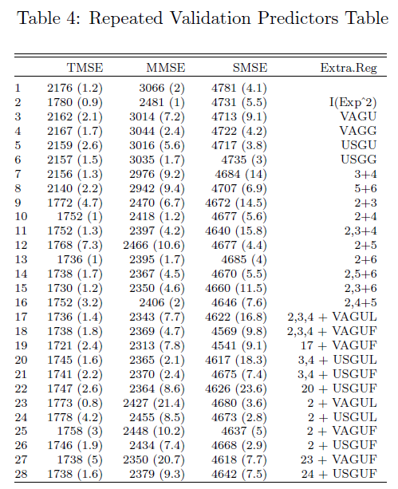
Results – some examples: repeated simple validation
Step one: Randomly divide original data into a training and test set (80/20 split)
Step two: Use one of the 28 linear models to the right to perform a regression on the training data:
Experience proxy
A set of dummy variables for degree held
A set of dummy variables for the work year in question.
Additional regressors listed on the right
Step three: Calculate mean standard error on the test set
Step four: repeat this process 100,000 times and find the average mean standard error and its standard deviation
Results: all predictors are shown to have predictive power, which grows with the inclusion of more predictors

Slide 13
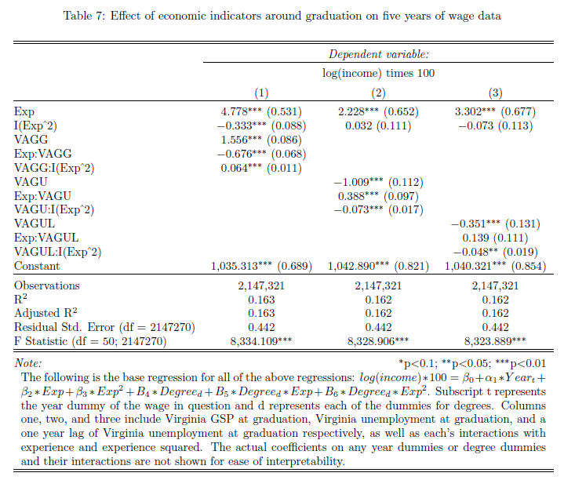
Results example 2 – first five years after graduation
As can be seen from the table to the right, the effect of economic indicators around graduation is greatest during the first working year, and then shrinks over time.
Indicator name | Indicator meaning
VAGG | Virginia GSP growth at graduation
VAGU | Virginia unemployment at graduation
VAGUL | Virginia unemployment one year before graduation

Slide 14
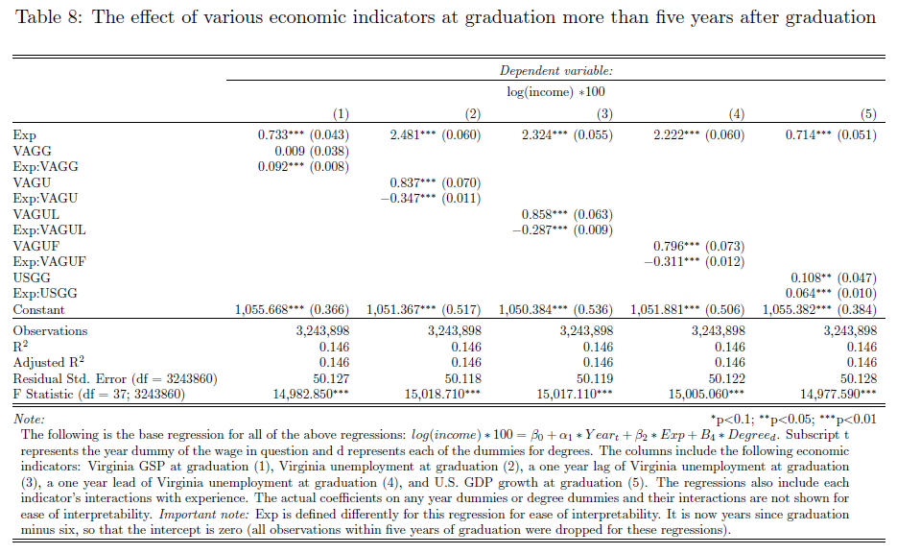
Results example 3 -- > five years after graduation
Notes:
To be able to interpret the table, you need to know the distribution of my so called Exp variable which I described above. The mean value of this "Exp" for all remaining simulated observations is 4.309.
the observations with the mean amount of the newly formed Exp variable experience the following effects: about 0.66% lower wages per point of extra Virginia unemployment at graduation, about 0.38% lower wages per point of extra lagged Virginia unemployment at graduation, about 0.54% lower wages per point of extra Virginia unemployment one year after graduation, and about 0.38% per extra point of U.S. GDP growth at graduation.

Slide 15
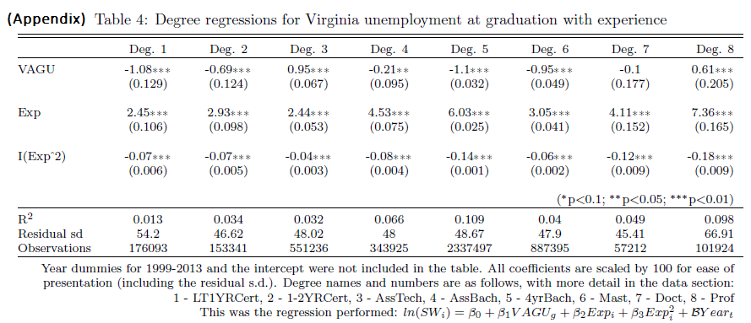
Results example 5 – individual degree regressions
Each column represents 100 aggregated regressions with a new random simulation of individual earnings given a log normal mean and standard deviation. Most of the individual degree regressions show that two degree types react in an opposite manner to what is expected for a given economic indicator: Associate’s degrees with technical credits and professional degrees.

Slide 16
Potential biases and reasons for underestimation of true relationship
Very slight underestimation bias from slight lack of distributional fit
More serious underestimation bias from experience proxy being overestimated for graduates in poor economic times versus good economic times
Yet, virtually all of the results are very significant, statistically and economically, and point in the right direction.
Another problem is that the estimated effects are conditional on being employed, and so underestimate the true wage losses from poor economic indicators at graduation. If individual level data were available, the effect of time spent unemployed on lost wages could be estimated.

Slide 17
Conclusions
Almost all results point to all tested economic indicators around graduation, including lags and leads of one year, have statistically and economically important effects in the expected direction on the order of 0.5% - 1% per percentage point growth or unemployment off of the average.
Further subdivision of the data based on extreme economic events or recent graduates versus those who have already graduated for many years yields more insight, and shows the effect is largely isolated to the first few years after graduation and operates mainly through lower full time employment.
The economic effects of graduating in poor times were as expected and the results seem to be quite robust.

Slide 18
Thank you! Questions?
References
Cutler, Huang, and Muney 2015. 'When does education matter? The protective effect of education for cohorts graduating in bad times.' Social Science and Medicine,127, 63-73.
Davis, Steven, and Till Von Wachter 2011. "Recessions and the Costs of Job Loss,” Brookings Papers on Economic Activity, Economic Studies Program, The Brookings Institution, vol. 43(2 (Fall)), 1-72.
Genda, Yuji, Kondo, Ayako, Ohta, and Souichi, 2010. 'Long-term effects of a recession at labor market entry in Japan and the United States.' Journal of Human Resources, 45, 157-196.
Kahn, Lisa 2010. 'The long-term labor market consequences of graduating from college in a bad economy.' Labor Economics, Volume 17, Issue 2, April 2010, 303-316.
Oreopoulous, Phil, Till von Wachter, and Andrew Heisz 2012. 'The Short- and Long-Term Career Effects of Graduating in a Recession: Hysteresis and Heterogeneity in the Market for College Graduates.' American Economic Journal: Applied Economics, Vol. 4, Number 1.

